Slide 1

Order And Stock Analysis
(Inventory Data Mini Project)
ABDUL AZIZ AKBANI
© All rights reserved by Fireblaze Technologies Pvt. Ltd.

Slide 2
Problem Statement
In this project, we will analyze sales data and stock information to gain insights into the performance of different SKU IDs over time. By identifying top-selling SKU IDs and tracking yearly sales trends, we can make informed decisions about stock management and sales strategies. Using visualizations, we can understand the dynamics of product(SKU IDs) sales and communicate our findings effectively.
© All rights reserved by Fireblaze Technologies Pvt. Ltd.

Slide 3
Proposed Solution
Data Preprocessing: Clean and preprocess the data by handling missing values, data inconsistencies, and data type conversions. Merge relevant datasets, such as past orders and stock information, based on a common identifier (SKU ID).
Yearly Sales Analysis: Grouped the data by year and calculate the total sales quantity for each year. Visualize the yearly sales trend using line plots and hist plots, identifying any significant changes or patterns over time.
© All rights reserved by Fireblaze Technologies Pvt. Ltd.

Slide 4
Proposed Solution
SKU ID Performance Analysis: Analyze the performance of SKU IDs based on sales quantities. Identify top-selling SKU IDs by aggregating and ranking sales quantities. Visualize the sales distribution across SKU IDs using bar plots or other suitable visualizations.
Stock Analysis: Utilize the stock information to analyze inventory levels, average lead time, and maximum lead time for each SKU ID. Identify any stock shortages, excesses, or potential stock management issues.
© All rights reserved by Fireblaze Technologies Pvt. Ltd.

Slide 5
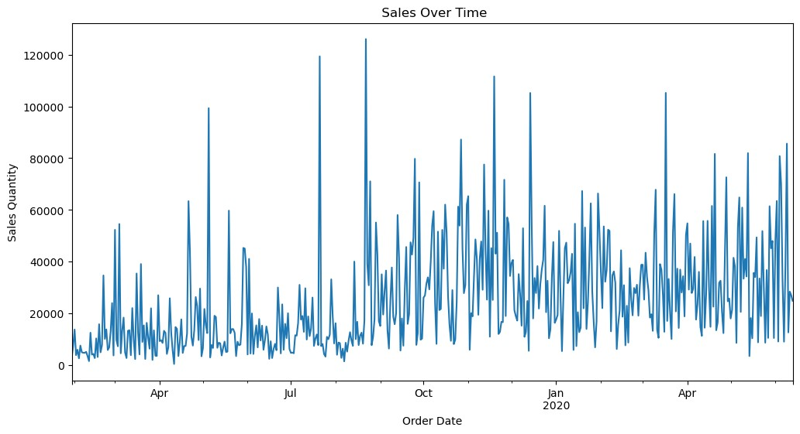
Sales Over Time:
Sales over time graph provides a visual representation of sales quantity trends.
Helps track the performance and identify patterns in sales data.
Analysis of the graph can provide insights into growth, seasonality, and fluctuations in sales over different periods.
This information empowers businesses to make informed decisions regarding sales strategies, inventory management, and forecasting.

Slide 6
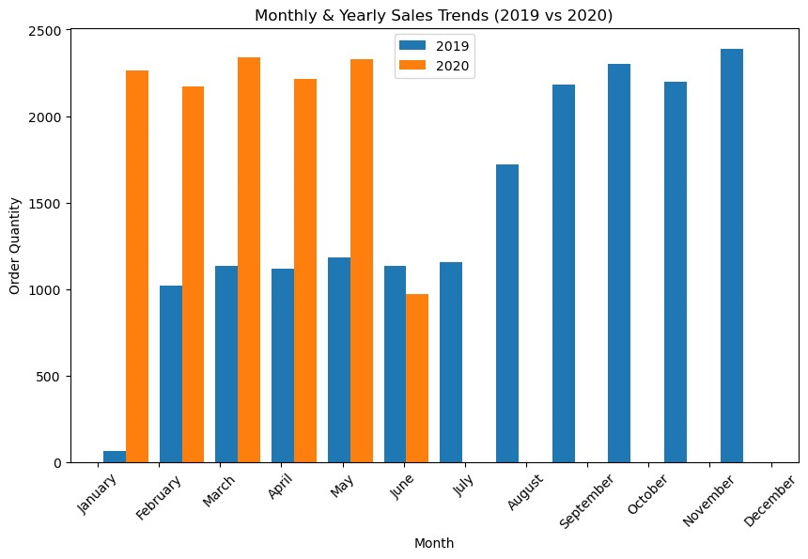
Monthly & Yearly Sales Trends (2019 vs 2020):
When we look at our sales data over a longer period of time, like a year, we might not notice patterns that happen during certain months or quarters.
For example, maybe we sell more during the winter holidays. By looking at our sales data by month or quarter, we can see these patterns more clearly.
This can help us to make better decisions about how to sell our products or services. We used bar graph to help us see these patterns more easily and find ways to sell more during the times when you typically sell more.

Slide 7
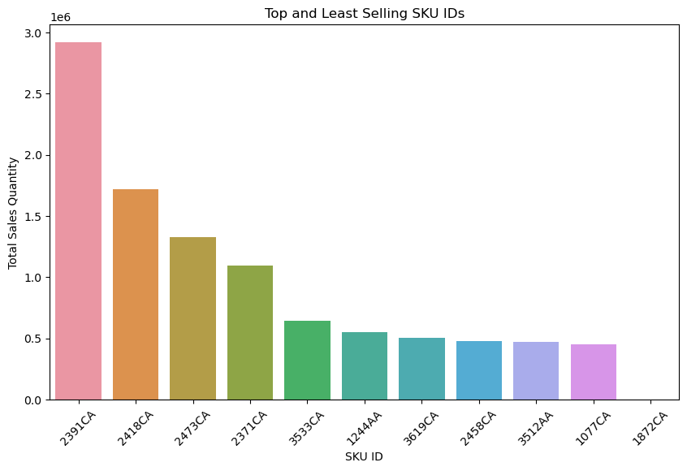
Top Selling SKU IDs:
Based on the sales data analysis, it was found that the top-selling SKU IDs are 2391CA, 2418CA, and 2473CA.
These products have higher sales quantities compared to other products, and as such, focusing on them can help optimize inventory and marketing strategies to maximize sales and profits.

Slide 8
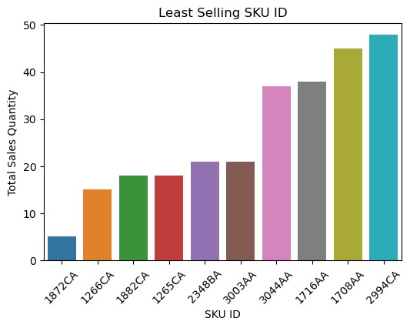
Low Selling SKU IDs:
Based on the sales data analysis, it was found that the least-selling SKU IDs are 1872CA, 1266CA, and 1882CA.
On the other hand, examining the least selling SKU IDs helps us identify areas for improvement and potential opportunities for growth.
By understanding the reasons behind their lower sales performance, such as limited customer demand, suboptimal marketing strategies, or competitive challenges, we can make informed decisions to revitalize these products or reallocate resources to more profitable areas.

Slide 9
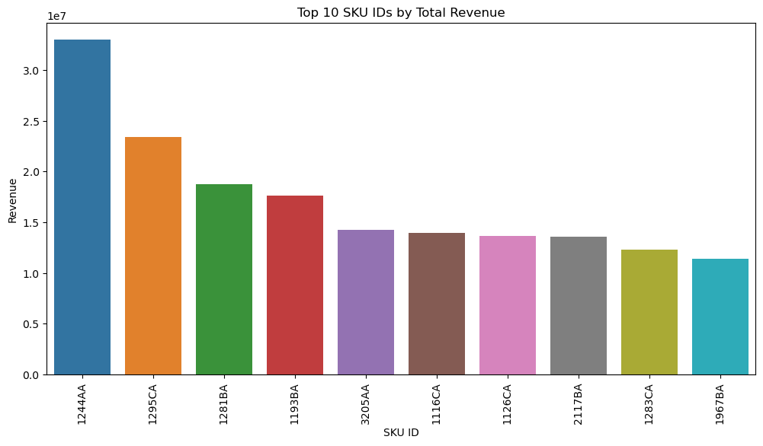
Top Revenue Generating SKU IDs :
Through sales data analysis, we have identified the top revenue generating SKU IDs as 1244AA, 1295CA, and 1281BA..
After identifying the most revenue generating SKU IDs, We should consider the following actions:-
Increase the inventory of the top-performing SKU IDs to meet demand.
Analyze the sales data of the top-performing SKU IDs to identify patterns and trends.
Adjust sales strategies to promote the top-performing SKU IDs.
Use the sales data of the top-performing SKU IDs to inform forecasting and budgeting decisions.

Slide 10
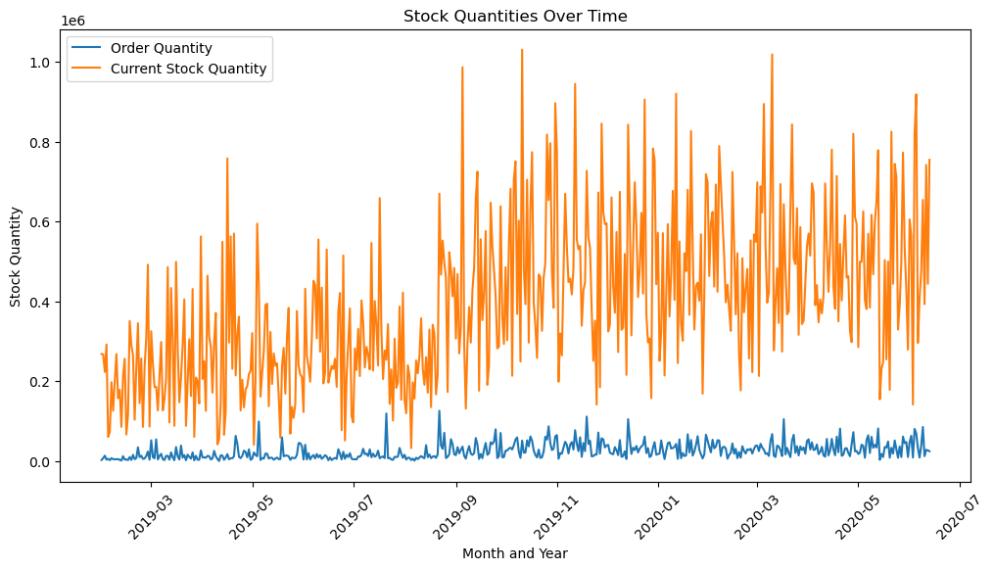
Stock Quantities Analysis :
Through analysis of the stock and order quantities over time, We have observed that the Current Stock Quantities consistently exceed the corresponding Order Quantities.
This suggests that there is an overstock of the product represented by SKU IDs, as reflected by the Current Stock Quantities.
Adjust the inventory management practices to optimize stock levels.
Develop sales strategies to promote the overstocked product and reduce inventory.
Consider offering discounts or promotions to incentivize customers to purchase the overstocked product.
Monitor the sales data of the overstocked product to identify trends and adjust inventory levels accordingly.

Slide 11
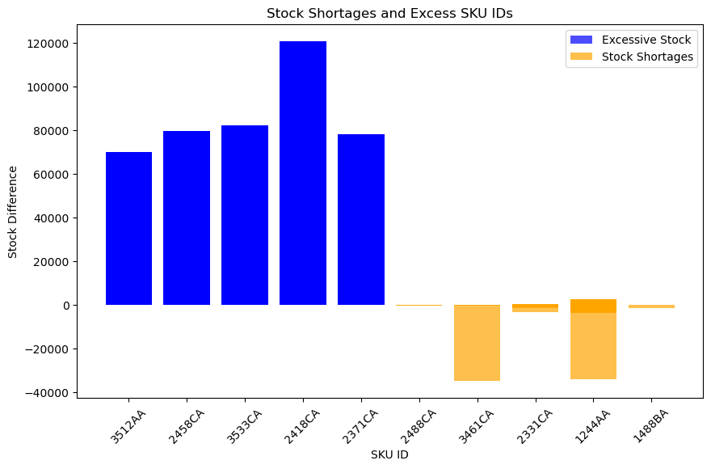
Identifying Stock Shortages Or Excess :
We have identified that the following SKU IDs have excessive stock levels: 3512AA, 2458CA, 3533CA, 2418CA, and 2371CA.
Conversely, SKU IDs 2488CA, 3461CA, 2331CA, 1244AA, and 1488BA are facing stock shortages.
These discrepancies in stock levels can result in unnecessary costs and reduced profitability, as well as decreased customer satisfaction due to stockouts.
As a result, we will be implementing inventory management strategies to optimize our stock levels and reduce excess inventory, while also ensuring that we have adequate stock levels of our most in-demand products.
By doing so, we can improve our overall efficiency, increase profitability, and provide better value to our customers

Slide 12
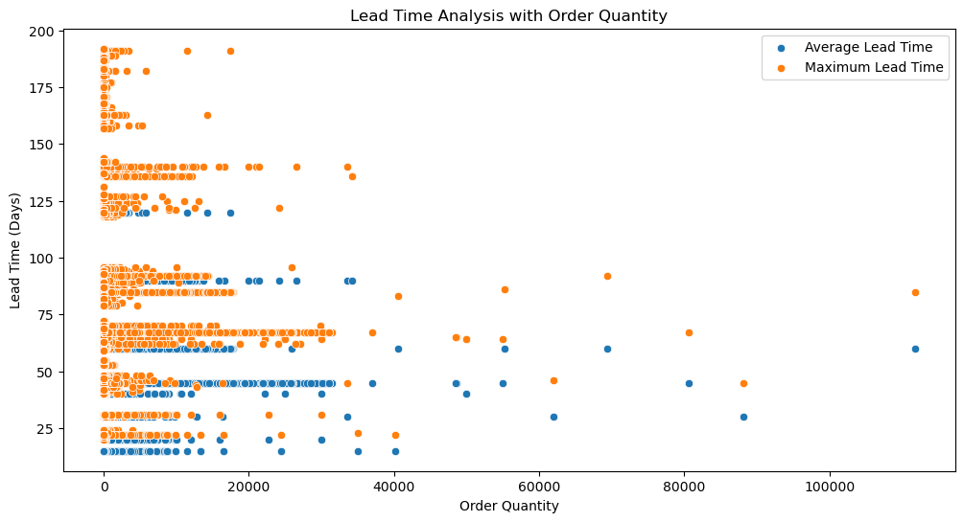
Lead Time Analysis with Order Quantity :
Maximum lead time: This refers to the longest amount of time it can take to fulfill an order. It's important to account for the maximum lead time when planning their inventory and order fulfillment processes to ensure that they have adequate stock levels and can meet customer demand in a timely manner.
Average lead time: This refers to the typical amount of time it takes to fulfill an order. By calculating the average lead time so we can better plan our inventory and order fulfillment processes to ensure that they have adequate stock levels and can meet customer demand in a timely manner. It's important to note that the average lead time can vary depending on factors such as the supplier, the product, and other variables.

Slide 13
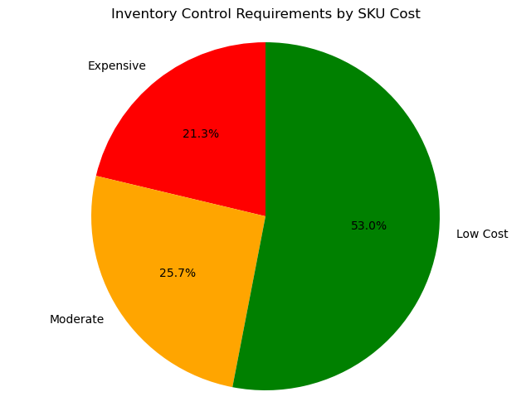
Inventory Control :
Expensive : High-value items that are used frequently. These items represent a relatively small percentage of the total inventory but account for a large percentage of the total value. They require close monitoring and control to ensure that they are always in stock.
Moderate : Moderate-value items that are used less frequently than Expensive items. These items represent a moderate percentage of the total inventory and value. They require a moderate level of monitoring and control to ensure that they are in stock when needed.
Low Cost: Low-value items that are used infrequently. These items represent a large percentage of the total inventory but account for a small percentage of the total value. They require minimal monitoring and control and can be managed with less attention than Expensive and Moderate items.

Slide 14
Descriptive Analysis
Data Understanding: Familiarize with the dataset's structure, variables, and their meanings. Understand the data sources and any potential limitations or biases.
Data Cleaning and Preprocessing: Cleaned the data by addressing missing values, handling outliers, and resolving any inconsistencies or errors. Ensure that the data is in the appropriate format for analysis.
Grouping and Aggregation: Group the data based on relevant factors (e.g., year, category) and calculate aggregate measures. This allows for deeper insights into subsets of the data.
Visualization: Created visualizations to explore the data and gain insights. Use appropriate charts, graphs, and plots to depict the distribution, relationships, and trends within the data.
© All rights reserved by Fireblaze Technologies Pvt. Ltd.

Slide 15
Effect of Data Preprocessing
Data Quality Improvement: Preprocessing techniques, such as handling missing values, outliers, and errors, help improve the overall quality of the data. By addressing missing or erroneous data points, you can reduce biases and improve the reliability of your analysis.
Enhanced Data Consistency: Consistent data is essential for accurate and reliable analysis. Preprocessing techniques such as converting data types, standardizing units of measurement, and resolving inconsistencies in variables or categories help ensure that the data is consistent and follows a standardized format. This consistency enables accurate comparisons, calculations, and analysis. By addressing inconsistencies and standardizing data, we can increase the reliability of our analysis and make informed decisions based on accurate and consistent data.
© All rights reserved by Fireblaze Technologies Pvt. Ltd.

Slide 16
Optimisation
Optimizing the stock levels of different products based on their sales trends, lead times, and order quantities. The goal is to ensure that you have enough stock to meet customer demand while minimizing excess inventory and associated costs. This means that you need to carefully monitor sales trends and adjust your stock levels accordingly, while also considering how long it takes to receive new inventory and how much you need to order. By doing so, you can ensure that you always have the right amount of stock on hand to meet customer needs, while also minimizing the costs associated with holding excess inventory.
Leverage insights from top-selling and least-selling SKU IDs to develop targeted sales and marketing strategies. Focus on promoting and upselling popular products, while exploring opportunities to improve the performance of low-performing SKUs.
Identify and address bottlenecks or inefficiencies in the supply chain that may be causing longer lead times or stock shortages.
© All rights reserved by Fireblaze Technologies Pvt. Ltd.

Slide 17
Conclusion
In conclusion, the analysis revealed sales trends, identified top-selling SKU IDs, highlighted the importance of stock management, and provided insights for lead time optimization. Opportunities for improvement include inventory management, supply chain optimization, sales and marketing strategies and lead time reduction. Implementing these optimizations can drive growth and profitability for the business.
© All rights reserved by Fireblaze Technologies Pvt. Ltd.

Slide 18
Future Scope
The future of the project involves analyzing customer behavior and preferences, forecasting demand, and integrating with CRM systems.
Exploring e-commerce platforms and online sales channels will involve looking at how we can expand our online presence and reach more customers through channels such as Amazon, eBay, and other marketplaces.
Additionally, exploring advanced machine learning techniques for predictive analytics and incorporating real-time data for agile decision-making would be valuable for future development.
© All rights reserved by Fireblaze Technologies Pvt. Ltd.

Slide 19
Thank you!
© All rights reserved by Fireblaze Technologies Pvt. Ltd.

